Slide 1
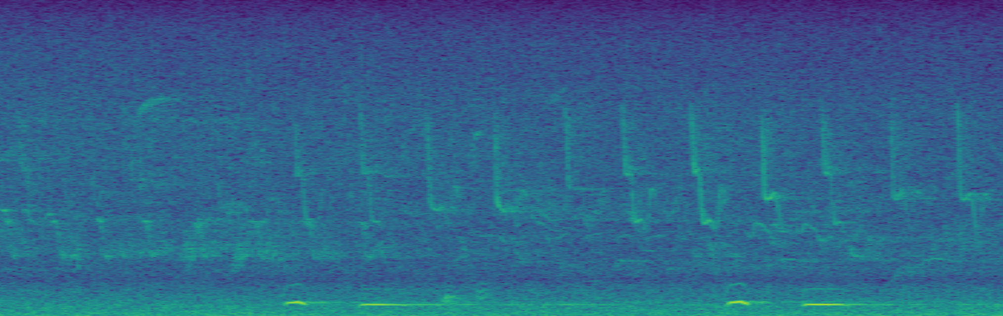
Task 4: Challenge
Team Vegetable
Sandro Assek
Petruta-Simina Coroian
Lukas Himmelbauer
Christoph Wittner

Slide 2
Data split
To be able to evaluate the learned models also offline (not on the challenge server), we split the given training samples into two sets, using 4/5 to train models and 1/5 to estimate the total savings
This was done by assigning 20% of files of every bird class to the test set, to ensure that the models never see any part of the recordings used for testing during the model selection procedure

Slide 3
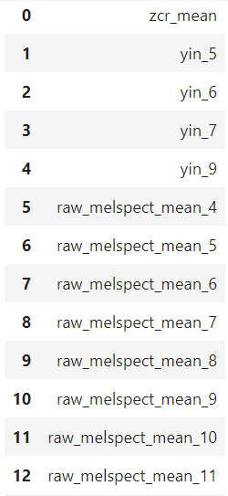
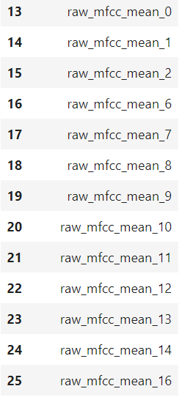
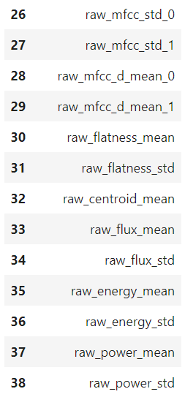
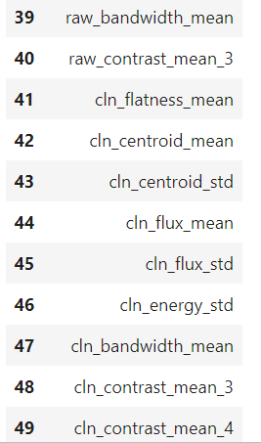
Top 50 Features chosen by mutual information gain

Slide 4
Stratified CV
For all of our experiments the training data was again split in 5 folds to do cross-validation. We used stratified cross-validation provided by sklearn, as we want to ensure that we have samples of each class in all 5 folds.
Our results are averaged over the 5 folds to get a more confident estimate than by only taking one split of the data

Slide 5
Post-processing
Flip single and double gaps (zero predictions between bird call predictions), as they are not considered during evaluation and this lets us get rid of wrongly predicted interruptions in longer calls
Slide a 6s (30 data points) window over the predictions and predict the most occurring bird, as the data consists of snippets of at least 6s containing only one bird

Slide 6
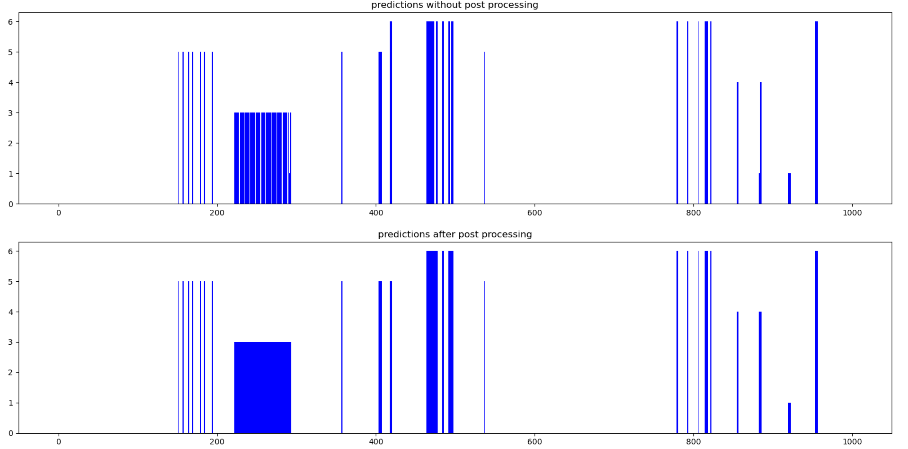
Post-processing
As visible in the picture, small gaps in the predictions have been removed and the predicted bird is more consistent than before

Slide 7
NN

Slide 8
CNN
The best results we got were obtained using a CNN. In order to be able to use Cnns, the data loading had to be slightly adjusted, as we needed whole sequences instead of single data points as input.
Since we have 10-minute recordings (3000 data points) as Test data, the 20s recordings we got as training data were concatenated 30 times to get the correct shape (instead of padding the sequence as this would have led to training data consisting of only 1/30 actual data and 29/30 padding values)

Slide 9
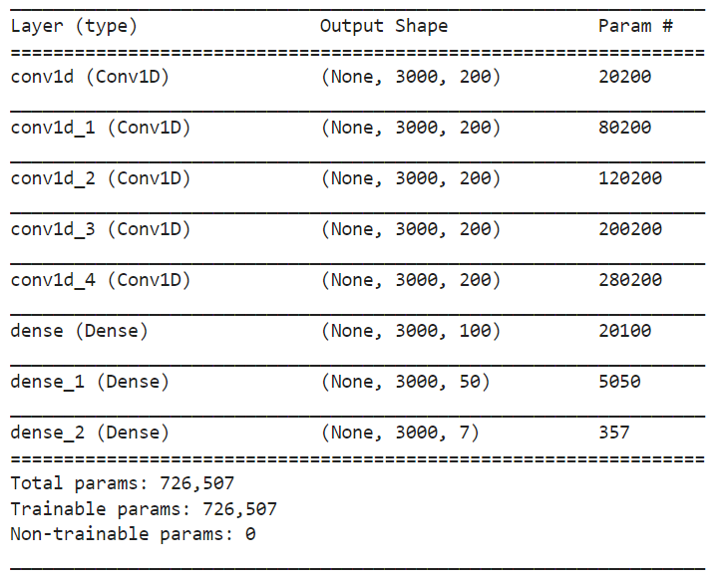
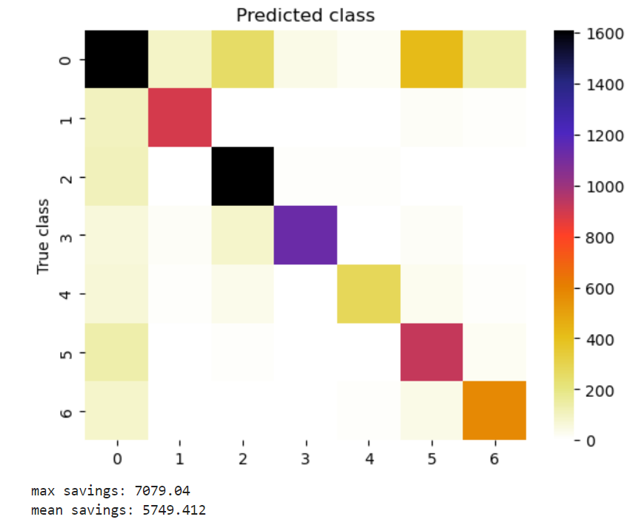
CNN
Architecture
Results:

Slide 10
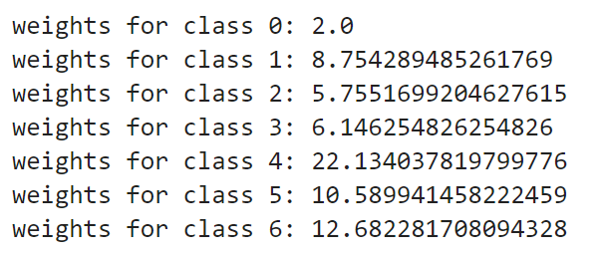
Gradient Boosting
To account for the inbalance of classes, sample weights were calculated to give a higher importance to samples of classes that don‘t occur that often
These class weights were calculated by taking the reciprocal value of the number of times each class occured in the data set
After deviding the weights by 2 and
setting the weight for class 2 to 2 the
resulting weights are:

Slide 11
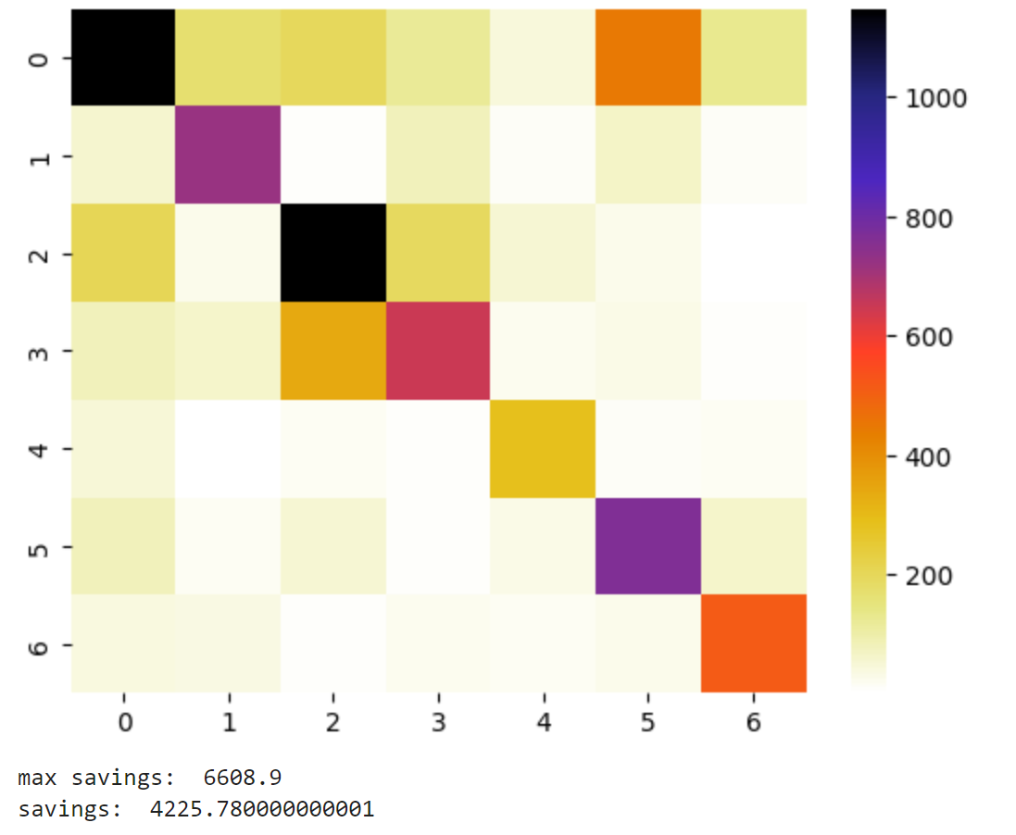
Gradient boosting
With 300 estimators, a learning rate of 0.1 and a max_depth of 3 the resulting confusion matrix and savings are:

Slide 12
SVM

Slide 13
Conclusion?

